Slide 1
Privacy preserving data publishing
Xinhui XU

Slide 2
Background
The collection of digital information → knowledge- and information-based decision making
Original data contains sensitive information about individuals → violate individual privacy
Relational tables are considered here
Notes:
The collection of digital information by governments, corporations, and individuals has created tremendous
opportunities for knowledge- and information-based decision making.
We are not talking about semi-structured or free-text data

Slide 3
Data flow

Slide 4
Collected data
Non-sensitive | Sensitive
Job | Sex | Age | Disease
Engineer | Male | 35 | Hepatitis
Engineer | Male | 38 | Hepatitis
Lawyer | Male | 38 | HIV
Writer | Female | 30 | Flu
Writer | Female | 30 | HIV
Dancer | Female | 30 | HIV
Dancer | Female | 30 | HIV
Table 1. Inpatient data to be published

Slide 5
Privacy leakage
Non-sensitive | Sensitive
Name | Job | Sex | Age
Emily | Dancer | Female | 30
Alice | Writer | Female | 30
Irene | Dancer | Female | 32
Bob | Engineer | Male | 35
Henry | Lawyer | Male | 38
Job | Sex | Age | Disease
Engineer | Male | 35 | Hepatitis
Engineer | Male | 38 | Hepatitis
Lawyer | Male | 38 | HIV
Writer | Female | 30 | Flu
Writer | Female | 30 | HIV
Dancer | Female | 30 | HIV
Dancer | Female | 30 | HIV
Table 1. Inpatient data to be published
Table 2. External table

Slide 6
Linkage Attacks
Non-sensitive | Sensitive
Name | Job | Sex | Age
Emily | Dancer | Female | 30
Job | Sex | Age | Disease
Dancer | Female | 30 | HIV
Dancer | Female | 30 | HIV
Record Linkage: a victim is linked to a small number of records in a table
Attribute Linkage: an attacker may not precisely identify the record of the target victim, but could infer his sensitive values from published data table
Attacker can assume the record of victim must be contained in the original data, but cannot guarantee it is published → another question we are not to consider here
Non-sensitive | Sensitive
Name | Job | Sex | Age
Alice | Writer | Female | 30
Job | Sex | Age | Disease
Writer | Female | 30 | Flu
Writer | Female | 30 | HIV

Slide 7
Quasi-identifier(QI/QID)
A set of non-sensitive attributes {Q₁, . . . ,Q_{w}} of a table is called a quasi-identifier if these attributes can be linked with external data to uniquely identify at least one individual in the table
In previous Table 1 and Table 2 :
Quasi-identifiers can be any non-empty subset of {Job, Sex, Age}
Table 1. Inpatient data to be published
Table 2. External table
Non-sensitive | Sensitive
Name | Job | Sex | Age
Job | Sex | Age | Disease

Slide 8
Equivalence class/Group
Records having same value qid on quasi-identifier attributes compose an equivalence class, also called group

Slide 9
K-anonymity
To prevent record linkage through quasi-identifier
K-anonymity: if one record in the table has some value qid, at least k− 1 other records also have the value qid. In other words, the minimum equivalence class/group size on QID is at least k

Slide 10
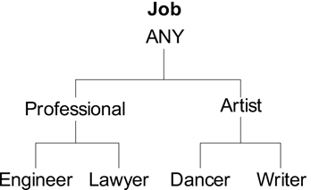
K-anonymity Example
Non-sensitive | Sensitive
Non-sensitive | Sensitive
Name | Job | Sex | Age
Emily | Dancer | Female | 30
Alice | Writer | Female | 30
Irene | Dancer | Female | 32
Bob | Engineer | Male | 35
Henry | Lawyer | Male | 38
Job | Sex | Age | Disease
Engineer | Male | 35 | Hepatitis
Engineer | Male | 38 | Hepatitis
Lawyer | Male | 38 | HIV
Writer | Female | 30 | Flu
Writer | Female | 30 | HIV
Dancer | Female | 30 | HIV
Dancer | Female | 30 | HIV
Job | Sex | Age | Disease
Professional | Male | [35-40) | Hepatitis
Professional | Male | [35-40) | Hepatitis
Professional | Male | [35-40) | HIV
Artist | Female | [30-35) | Flu
Artist | Female | [30-35) | HIV
Artist | Female | [30-35) | HIV
Artist | Female | [30-35) | HIV
Table 2. External table
Table 3. 3-anonymous patient table
Table 1. Inpatient data to be published
Here quasi-identifier is {Job, Sex, Age}

Slide 11
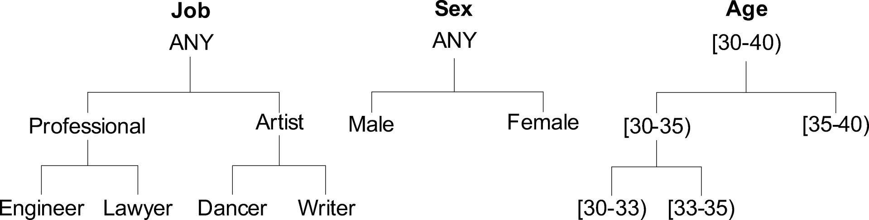
How come?
Sex
Male
Male
Male
Female
Female
Female
Female
Sex
Male
Male
Male
Female
Female
Female
Female
Job
Engineer
Engineer
Lawyer
Writer
Writer
Dancer
Dancer
Job
Professional
Professional
Professional
Artist
Artist
Artist
Artist
Age
35
38
38
30
30
30
30
Age
[35-40)
[35-40)
[35-40)
[30-35)
[30-35)
[30-35)
[30-35)
Generalization: replaces some values with a parent value in the taxonomy of an attribute
Categorical attribute and numerical attribute
Disease
Hepatitis
Hepatitis
HIV
Flu
HIV
HIV
HIV
Disease
Hepatitis
Hepatitis
HIV
Flu
HIV
HIV
HIV
Fig. 1. Taxonomy Trees for Job, Sex, Age
Notes:
For a categorical attribute, a specific value can be replaced with a general value according to a given taxonomy.
For a numerical attribute, exact values can be replaced with an interval that covers exact values.

Slide 12
Others stuffs
Specific algorithms → we are not to talk here
A combinatorial problem/search problem about finding the best generalization for each attribute from quasi-identifier
More generalized, much safer, but more information loss
Subset Property: Let QID’ ⊆ QID. If a table T is k-anonymous on QID, then T is also k-anonymous on QID’

Slide 13
L-diversity
To prevent attribute linkage through quasi-identifier
The L-diversity requires every qid group to contain at least L “well-represented” sensitive values
“Well-represented” means most frequent

Slide 14
Probabilistic attack
Non-sensitive | Sensitive
Name | Job | Sex | Age
Emily | Dancer | Female | 30
Alice | Writer | Female | 30
Irene | Dancer | Female | 32
Bob | Engineer | Male | 35
Henry | Lawyer | Male | 38
Job | Sex | Age | Disease
Professional | Male | [35-40) | Hepatitis
Professional | Male | [35-40) | Hepatitis
Professional | Male | [35-40) | HIV
Artist | Female | [30-35) | Flu
Artist | Female | [30-35) | HIV
Artist | Female | [30-35) | HIV
Artist | Female | [30-35) | HIV
Table 2. External table
Table 3. 3-anonymous patient table → 2-diversity

Slide 15
Other aspects
Attacker needs to eliminate at least L-1 sensitive values to uniquely identify one
Algorithms are not discussed here → change k-anonymity algorithm, as for equivalence class/group, test for l-diversity instead of k-anonymity.

Slide 16
Conclusion
Different privacy models ensure different levels of privacy requirements
Advanced problems:
Multiple sensitive attributes in table
Multiple publishing
Dynamic table or temporal table

Slide 17
Thanks!

